Slide 1
Dissecting the Scripture
Word-By-Word

Slide 2
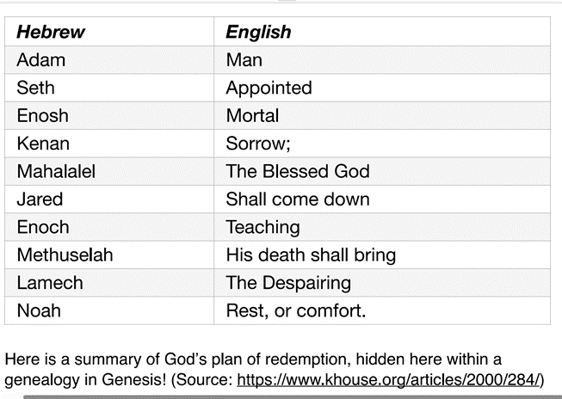
Genealogy Adam To Moses

Slide 3
Genealogy Abraham To Jesus
Abraham – Exalted father
Isaac – Laughter Uzziah – The Lord is my strength
Jacob – Heel catcher Jotham – God is perfect
Judah – Praise Ahaz – He has grasped
Perez – Breach- burst forth Hezekiah – God strengthens
Hezron – From walled town Manassen – Causing to forget
Ram – high, exalted Amos – to carry
Amminadab – My kinsmen or noble Josiah – to support
Nahshon – Enchanter Jeconian – God will fortify
Salmon – Peaceful Shealtiel – I have asked God
Boaz – Swiftness Zerubbabel – Sown in Babylon
Obed –Servant of God Abiud – My father is majesty
Jesse – The Lord exists Eliakim – God will develop
David – Beloved Azor – Helper Joseph – He will add
Solomon – Peaceful Zadok – righteous justice Jesus – Lord is
Rehoboam – An enlarged people Achim – God will establish salvation
Abijah – God is Father Eliud – God is great Christ - Messiah
Asa – Healer Eleazar – God has helped
Jehoshaphat – God has Judged Mattan - Gift
Joram - God is exalted Jacob – Heal catcher

Slide 4
I Samuel 18:10
¹⁰ The next day a harmful spirit (troubled disposition) from God rushed upon Saul, and he raved within his house while David was playing the lyre, as he did day by day. Saul had his spear in his hand. ¹¹ And Saul hurled the spear, for he thought, “I will pin David to the wall.” But David evaded him twice.

Slide 5
I Samuel 19:23
²³ And he went there to Naioth in Ramah. And the Spirit (Breath) of God (who judges) came upon him also, and as he went he prophesied (in oldest forms, of religious ecstasy with or without song and music; later, essentially religious instruction, with occasional predictions); — until he came to Naioth in Ramah.

Slide 6
Matthew 7:1-2
¹ “Judge (krinete by making a judgment – either positive (a verdict in favor of) or negative (which rejects or condemns) not, that you be not judged. ² For with the judgment you pronounce you will be judged, and with the measure you use it will be measured to you.

Slide 7
Time for Your Scripture Word Study

